Slide 1


Integrating Video Effectively in Teaching and Learning

Slide 2

Specific Objectives
Explain
Explain cognitive principles behind video use
Differentiate
Differentiate passive vs active video learning
Design
Design video-based instructional activities
Select
Select appropriate video tools
Evaluate
Evaluate instructional quality and accessibility

Slide 3


WHAT ARE VIDEOS IN EDUCATION
Videos in education are structured visual, and audio instructional material used to support teaching and learning objectives.
Notes:
They are designed to explain concepts, demonstrate processes, stimulate discussion, or reinforce understanding.
They may be teacher created, student created, professionally produced, live or recorded.

Slide 4

Question
Why do we use videos in Education?

Slide 5
Why Use Video in Education?
Enhances engagement and motivation
Supports visual and auditory learners
Enables self‑paced learning
Models real-world scenarios
Supports flipped classroom approaches

Slide 6


Question
Which Theories are supported by using videos in education

Slide 7

Theories Supported by VIDEOS IN EDUCATION
Videos provide visual experiences that help learners connect new information. Learners build knowledge actively. (Jean Piaget Constructivism)
Videos stimulate discussion, collaboration, and guided learning. (Lev Vygotsky Social constructivism)
Demonstration videos model behaviors, skills and problem-solving strategies. People learn by observing others. (Albert Bandura-Social Learning theory)
Videos reduce cognitive overload when designed properly. Learners understand better when information is presented using both words and visuals. (Richard Mayer Cognitive Theory of Multimedia Learning)
Videos stimulate real-life experiences that students can reflect on and analyze. Learning occurs through experience and reflection. (David Kolb-Experiential Learning)

Slide 8

Question
What does the following have to do with video selection, creation and editing?
Richard Mayer’s Cognitive Theory of Multimedia Learning
Benjamin Bloom’s Taxonomy of Educational Objectives
The Universal Design for Learning framework

Slide 9

Mayer’s Multimedia Learning Principles
Richard Mayer’s Cognitive Theory of Multimedia Learning
Coherence Principle
Signaling Principle
Redundancy Principle
Segmenting Principle

Slide 10
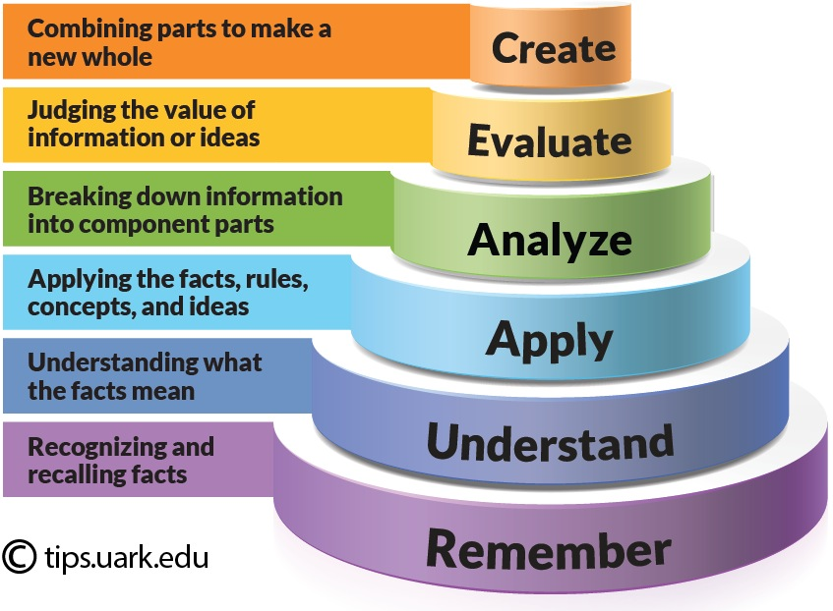
Aligning Video with Bloom’s Taxonomy
Remember
Remember: list key terms
Understand
Understand: summarize concepts
Apply
Apply: solve problems
Analyze
Analyze: compare methods
Evaluate
Evaluate: critique approaches
Create
Create: produce explanatory videos

Slide 11
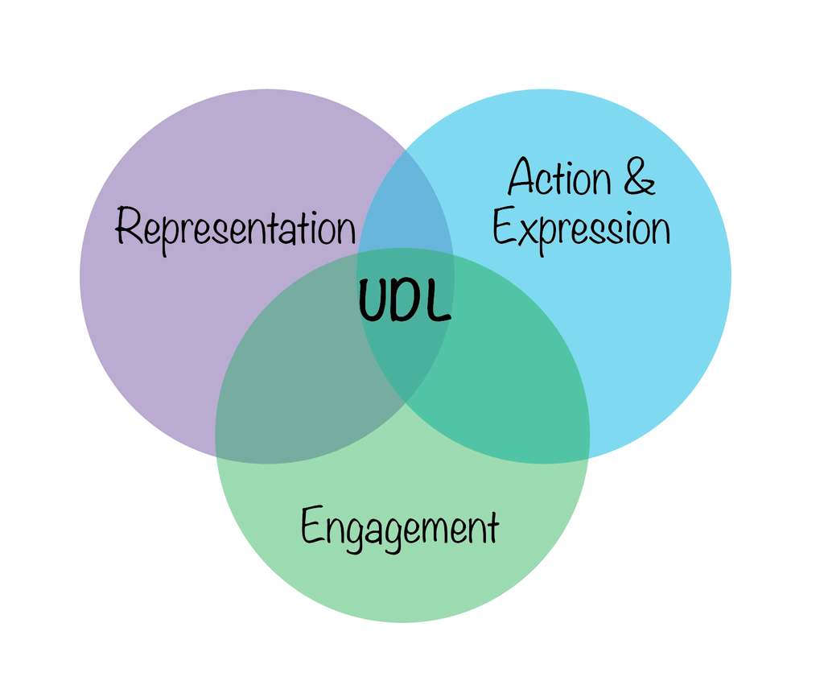
UDL- The Universal Design for Learning Framework and Videos
Multiple Means of Representation: Videos allow students to access information in their preferred format (audio/visual) rather than relying solely on text, supporting learners with disabilities or different learning preferences.
Multiple Means of Action & Expression: Students can produce videos (e.g., instead of a written report) to demonstrate understanding, which is particularly beneficial for students who struggle with writing or live presentations.
Multiple Means of Engagement: Both teacher-created and student-generated videos can recruit and sustain interest, making learning more meaningful.
…………………………………………………………………………………………………………………………………………….
Ensure Accessibility: Add captions and provide transcripts for all video content to make it accessible to all learners.
Student-Generated Content: Allow students to create videos to show what they have learned, fostering autonomy and creativity.
Interactive Elements: Use videos to provide, for example, a virtual, hands-on cooking recipe or a step-by-step tutorial.
Flexibility: Use videos as part of a varied, multi-sensory approach that minimizes reliance on lecturing

Slide 12

Types of Educational Videos
Explainer videos
Demonstrations and tutorials
Screencasts
Animated concept videos
Student-created videos
Interactive videos

Slide 13

Example Video Platforms
YouTube
Edpuzzle
Screencast-O-Matic
Microsoft Stream
CANVA
Final CUT-PRO
CapCut

Slide 14
Capcut example video

Slide 15
Passive vs Active Viewing
Passive: watching without guidance
No embedded questions or follow-up tasks
Active: pause-and-predict
Guided note-taking and reflection
Embedded quizzes and problem solving

Slide 16
Active Viewing Video Design
Watch
Watch a short instructional video
Redesign
Redesign for engagement
Apply
Apply Bloom’s Taxonomy
Incorporate
Incorporate UDL principles
Add
Add interactive questioning

Slide 17
Designing a Video Activity
Identify learning objectives
1
Determine video purpose
2
Keep videos concise (6–10 minutes)
3
Add interaction every 2–3 minutes
4
Include accessibility features
5

Slide 18

Accessibility Considerations
Captions and transcripts
Visual clarity
High audio quality
Inclusive design aligned to UDL

Slide 19
Which video is best for Skill Demonstration?
https://youtu.be/CtoVR5ZByoM?si=E7SuPcU3UQDRQaM3
https://youtu.be/K1OWW7O8dtA?si=ywoBu2Fne2fYcUHH
https://youtu.be/9KFKw9EzAxw?si=tALnb8lJp-3Z0MTG

Slide 20
Which video is best for the following objective?
Student should be able to Construct a 90 degree angle using a ruler and a pair of compasses
https://youtu.be/fB32jn6MDSg?si=7REs2wY8x7NCf92-
https://youtu.be/n2DoZZ7OtvE?si=-RQzetwDjStCkC5T

Slide 21
BENEFITS OF USING VIDEOS IN EDUCATION
Supports different learning styles
Simplifies abstract concepts
Increases student engagement
Improves retention and recall
Provides real-world context
Enhances digital literacy
Encourages self-paced learning

Slide 22
Which video is best for student engagement?
https://youtu.be/LR1TroBTlwA?si=JWTcC8p7CccTTEwh
https://youtu.be/kZOfLN4YqhY

Slide 23
Which video best Provides real-world context?
https://youtu.be/fPjZK2VnGBQ?si=qUNak8lqfRTYa_41
https://youtu.be/IdyGAjj2xAw

Slide 24


HOW TO USE VIDEOS AS A TEACHING TOOL
Pre teaching tool /Set induction
During instruction
Flipped classroom model
Skill Demonstration
Assessment tool
Student created learning
Differentiated instruction
Notes:
1. Pre-Teaching Tool/Set induction
Use short clips to introduce new topics.
Activate prior knowledge.
2. During Instruction
Pause for discussion.
Ask predictive questions.
Clarify difficult concepts.
3. Flipped Classroom Model
Students watch videos at home.
Classroom time is used for discussion and practice.
4. Skill Demonstration
Show step-by-step procedures.
Replay complex steps.
5. Assessment Tool
Embed quizzes in videos.
Ask reflective questions.
Use video analysis activities.
6. Student-Created Learning
Assign students to create explanatory videos.
Encourage peer teaching.
7. Differentiated Instruction
Provide varied video formats for different learning needs.
Allow replay for reinforcement.

Slide 25







BEST PRACTICES FOR USING VIDEOS
ALIGN VIDEOS WITH LEARNING OBJECTIVES
PROVIDE GUIDING QUESTIONS
PAUSE FREQUENTLY FOR ENGAGEMENT
LIMIT TEXT AND DISTRACTIONS
ENSURE ACCESSIBILITY WITH CAPTIONS AND CLEAR AUDIO
KEEP VIDEOS SHORT
FOLLOW UP WITH ACTIVE LEARNING TASKS

Slide 26
COMMON MISTAKES TO AVOID
Using videos as passive time fillers
Playing long videos without interaction
Not connecting videos to assessment
Overloading students with too much information
Failing to preview content

Slide 27
Points to remember!
Reflect on cognitive load
Consider risks of overusing video
Plan for active engagement

Slide 28
Also Remember!
Video must be intentional, not decorative
Short and segmented videos improve learning
Active engagement is essential
Accessibility should be built into design
Align video with objectives and assessment

Slide 29
Activity
Create a 3–5 minute instructional video
Develop script and storyboard aligned with listed objectives
Use Screencast-O-Matic, Microsoft Stream, Canva, CapCut or any other tool
Reflect on design decisions

Slide 30
CONCLUSION
Videos are not replacements for teachers. They are powerful instructional tools that enhance engagement, support multiple learning styles, encourage active learning and promote deeper understanding.

Slide 31
REFERENCES
Vygotsky, Lev (1978). Mind in Society. London: Harvard University Press.
Kretchmar, J. (2024). Social learning theory . EBSCO. https://www.ebsco.com/research-starters/education/social-learning-theory
‌Mayer, R. E. (2024). The Past, Present, and Future of the Cognitive Theory of Multimedia Learning. Educational Psychology Review, 36(8), 1–25. https://doi.org/10.1007/s10648-023-09842-1
‌Purdy, E. R. (2024). Kolb’s Experiential Learning Model | EBSCO. EBSCO Information Services, Inc. | Www.ebsco.com. https://www.ebsco.com/research-starters/education/kolbs-experiential-learning-model
‌Brame, C. J. (2016). Effective Educational Videos: Principles and Guidelines for Maximizing Student Learning from Video Content. CBE—Life Sciences Education, 15(4). https://doi.org/10.1187/cbe.16-03-0125

Slide 32


This Photo by Unknown Author is licensed under CC BY-NC

